Slide 1

Quantum Machine learning
Designing Algorithms

Slide 2
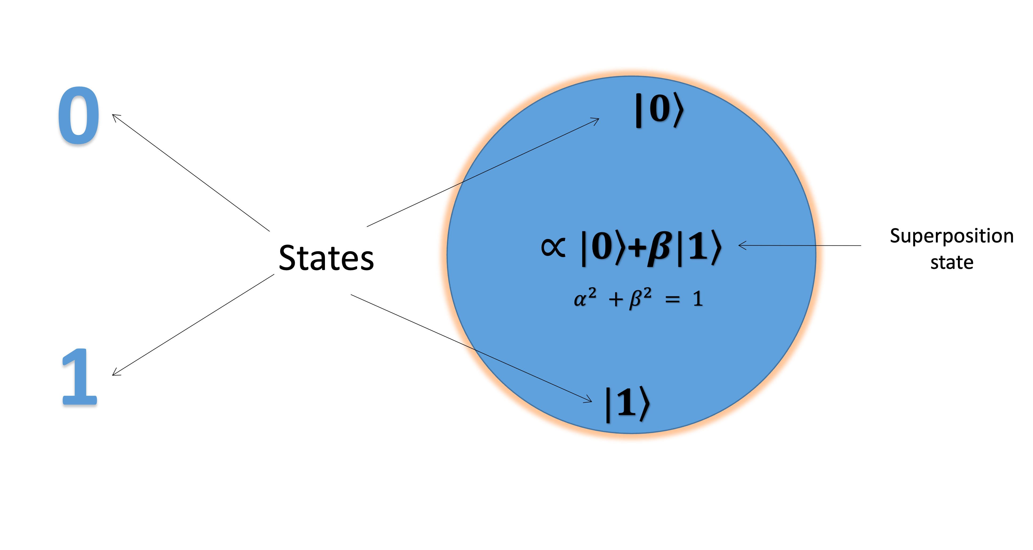
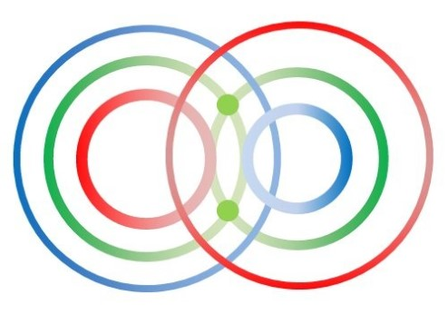
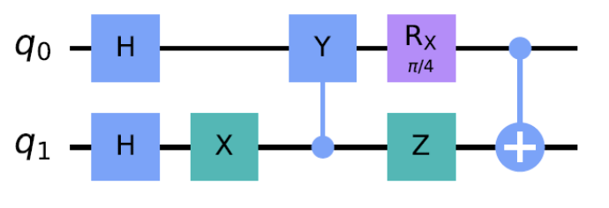
Basic Concepts in Quantum Computing (QC)
0
1
Classical computing (digital bits)
Quantum computing
(quantum bits/qubit)
Superposition
Entanglement
Quantum Circuit and Gate

Slide 3

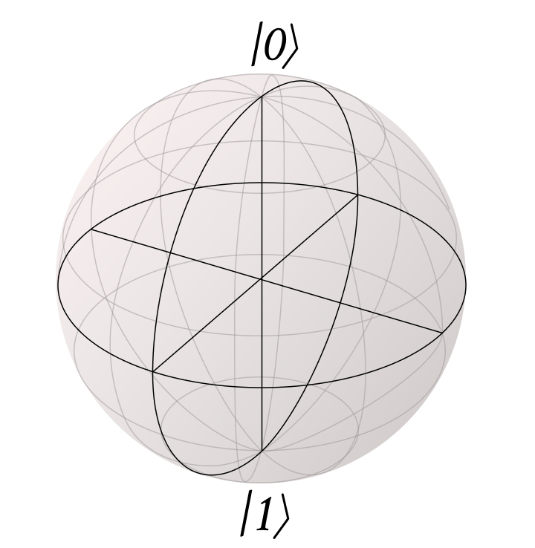
The Bloch sphere lets us represent all possible qubit states visually.
Kind of like how a globe lets us represent all possible places on Earth.

Slide 4
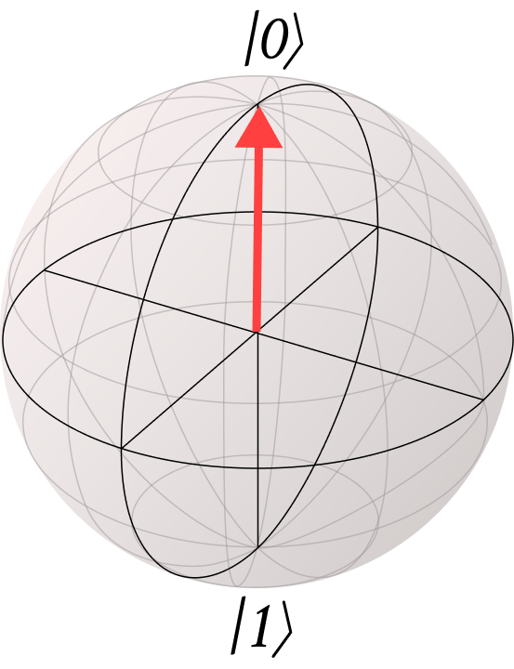
Landmarks on the Bloch Sphere
The |0> state is always on the top
We use the |0> and |1> states to orient a qubit on the Bloch Sphere.
The |1> state is always on the bottom

Slide 5
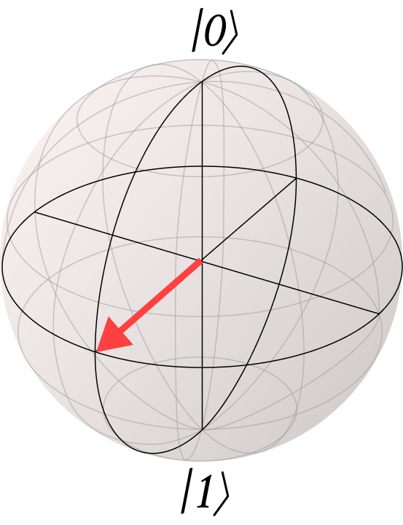
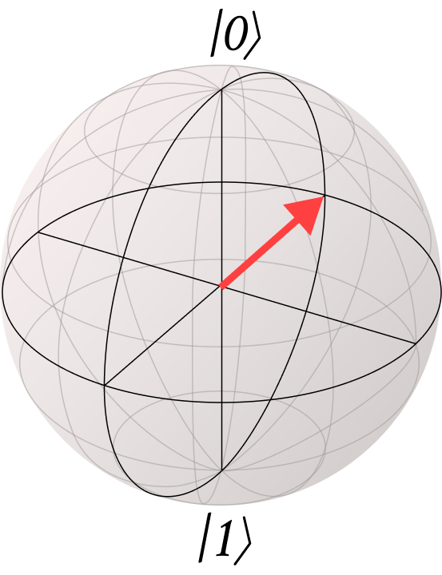
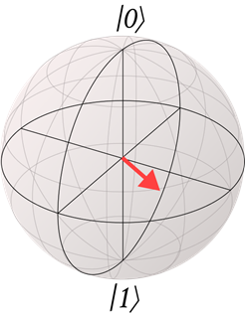
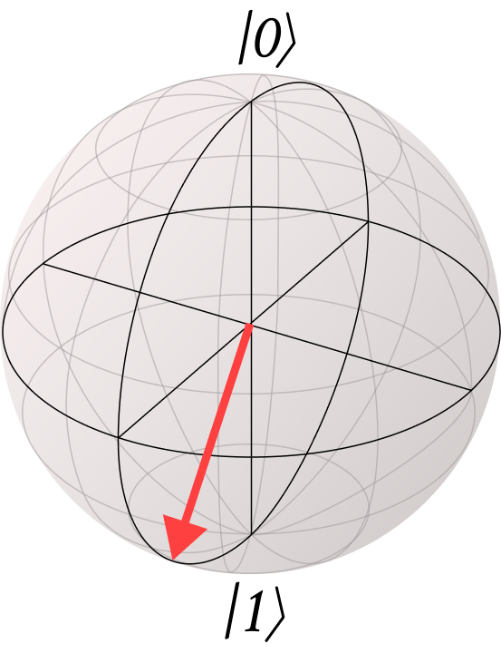
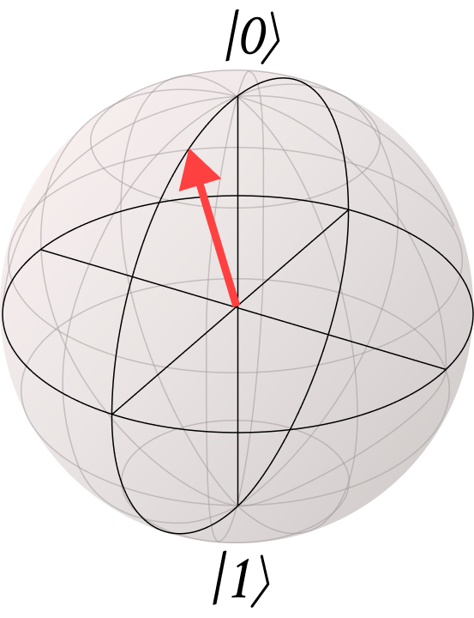
Locating a qubit on the Bloch sphere
Anything that is not |0> or |1> is a superposition.
Notes:
There are technically an infinite number of possible superpositions (points on the Bloch sphere)!
One of the key ideas with superposition is that it is not always equally split between the 0 and 1 states! For instance, the two large bloch spheres here show equal superpositions of 0 and 1. This means we have a 50% chance of measuring 0 and 50% chance of measuring 1. On the other hand, the three smaller Bloch spheres all show unequal superpositions. These are like an unfair coin where you have a greater chance of getting one outcome than another.
Any guesses based just on the pictures which Bloch sphere shows a state that’s much more likely to be measured as 1 than 0? Answer: The middle one since the arrow is closest to the 1 state.

Slide 6
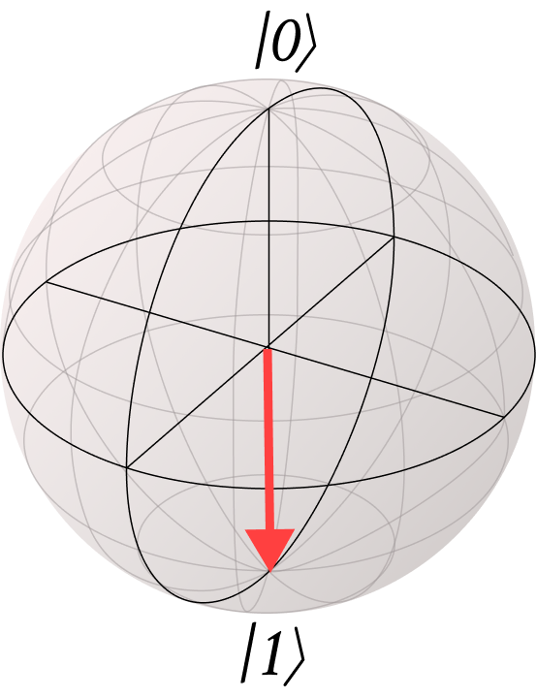
We use the Bloch Sphere to visualize qubits:
State of a Qubit
|0>
|1>
|+>
|->
Basis States
Superpositions
Notes:
Watch for animations

Slide 7
Practice: The Bloch Sphere
Which Bloch sphere shows a state that has a 20% contribution of |0> and a 80% contribution of |1> ?
a
b
c
d
- 7 -
© 2023 The Coding School

Slide 8
Practice: The Bloch Sphere
Which Bloch sphere shows a state that has a 70% contribution of |0> and a 30% contribution of |1> ?
a
b
c
d
- 8 -
© 2023 The Coding School

Slide 9
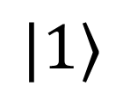
Practice: The X Gate
What do we get when we apply the following gate?
X
?
A
B
C
Notes:
The Z axis

Slide 10
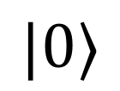
Practice: The X Gate
What do we get when we apply the following gate?
X
X
?
A
B
C
Notes:
The Z axis

Slide 11
Applications
*Qubits, gates, and measurements together make up quantum circuits
Quantum Algorithms and Protocols
Quantum Circuits
*
Quantum Gates and Measurement
Qubits

Slide 12
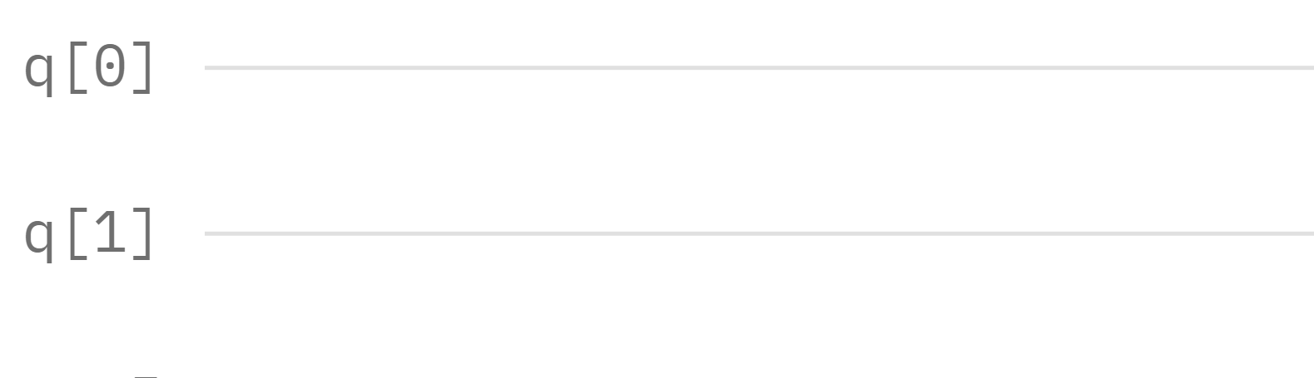
Quantum Circuits
When we string a bunch of quantum gates together, we draw them in the form of a Quantum Circuit.
In a quantum circuit, we represent each qubit as a line:
This circuit has 2 qubits
Notes:
Quantum circuits are our way of displaying gates and the order we apply them

Slide 13
Quantum Circuits
When we string a bunch of quantum gates together, we draw them in the form of a Quantum Circuit.
In a quantum circuit, we represent each qubit as a line:
These are the “names” of the qubits
Notes:
Quantum circuits are our way of displaying gates and the order we apply them

Slide 14
Remember, qubits are units of quantum information.
Other than a 0 state or a 1 state, they can also be in a superposition (combination) of both.
Quantum Gates are applied to change and manipulate qubits.
0
1

Slide 15

Z Gate
Rule: the Z gate is a 180° rotation around the z-axis.
The 0 state just spins in place:

Slide 16
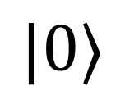
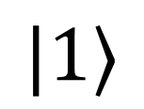
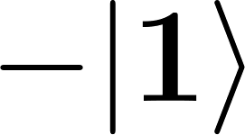
Input
Output
Rule: the Z gate is a 180° rotation around the z-axis.
Z
Z

Slide 17
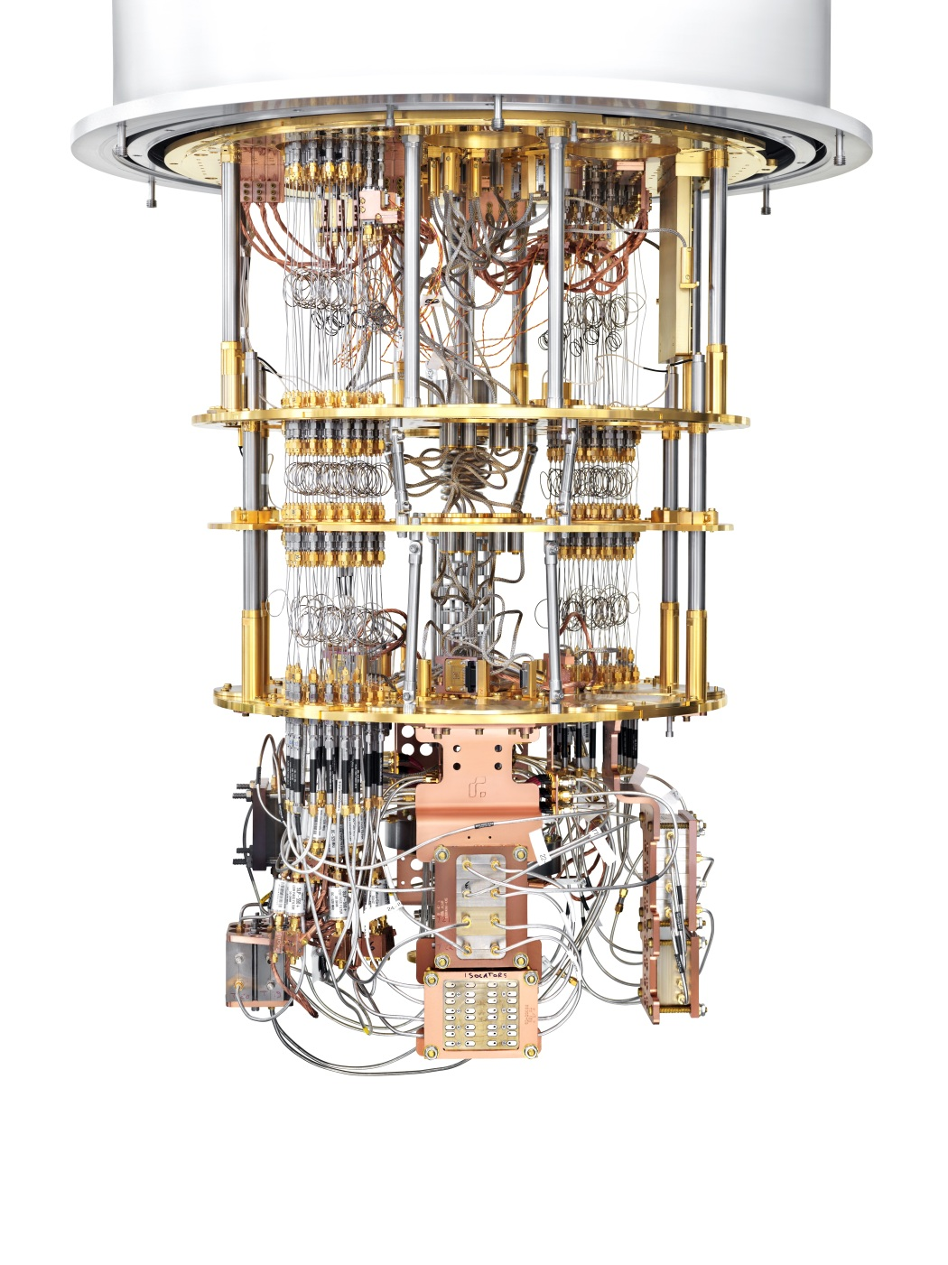
What is Quantum Machine Learning (QML)?
QML uses the power of quantum mechanics and quantum computing to speed up and enhance the machine learning done on the “classical” computers we use every day.

Slide 18
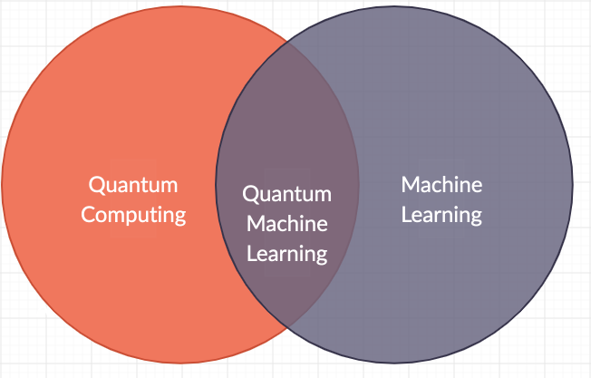
QML is at the intersection of Quantum Computing and Machine learning

Slide 19
Why is QML important?
Speed: Quantum computers can process information much faster than classical computers.
Complex Problem Solving: QML can tackle problems that are too complex for classical computers.
Advancing Technology: Understanding QML is crucial for future advancements in technology and science.

Slide 20
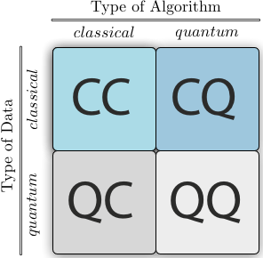
CC – Classical data, Classical Algorithm
CQ – Classical Data, Quantum Algorithm
QC – Quantum Data, Classical Algorithm
QQ- Quantum Data, Quantum Algorithm

Slide 21
Skill Check 1
A doctor took X-ray images and then designed a quantum circuit to understand the different patterns in the images.
Which category of Quantum Machine Learning does this application belong to
Ans:

Slide 22
Skill Check 2
Support vector classifier is used to classify the the properties of two quantum dots
Which category of Quantum Machine Learning does this application belong to
Ans:

Slide 23
Potential of QML
QML
Imaging
Machine learning enhancemnent
Simulating Quantum Systems
Drug Discovery

Slide 24
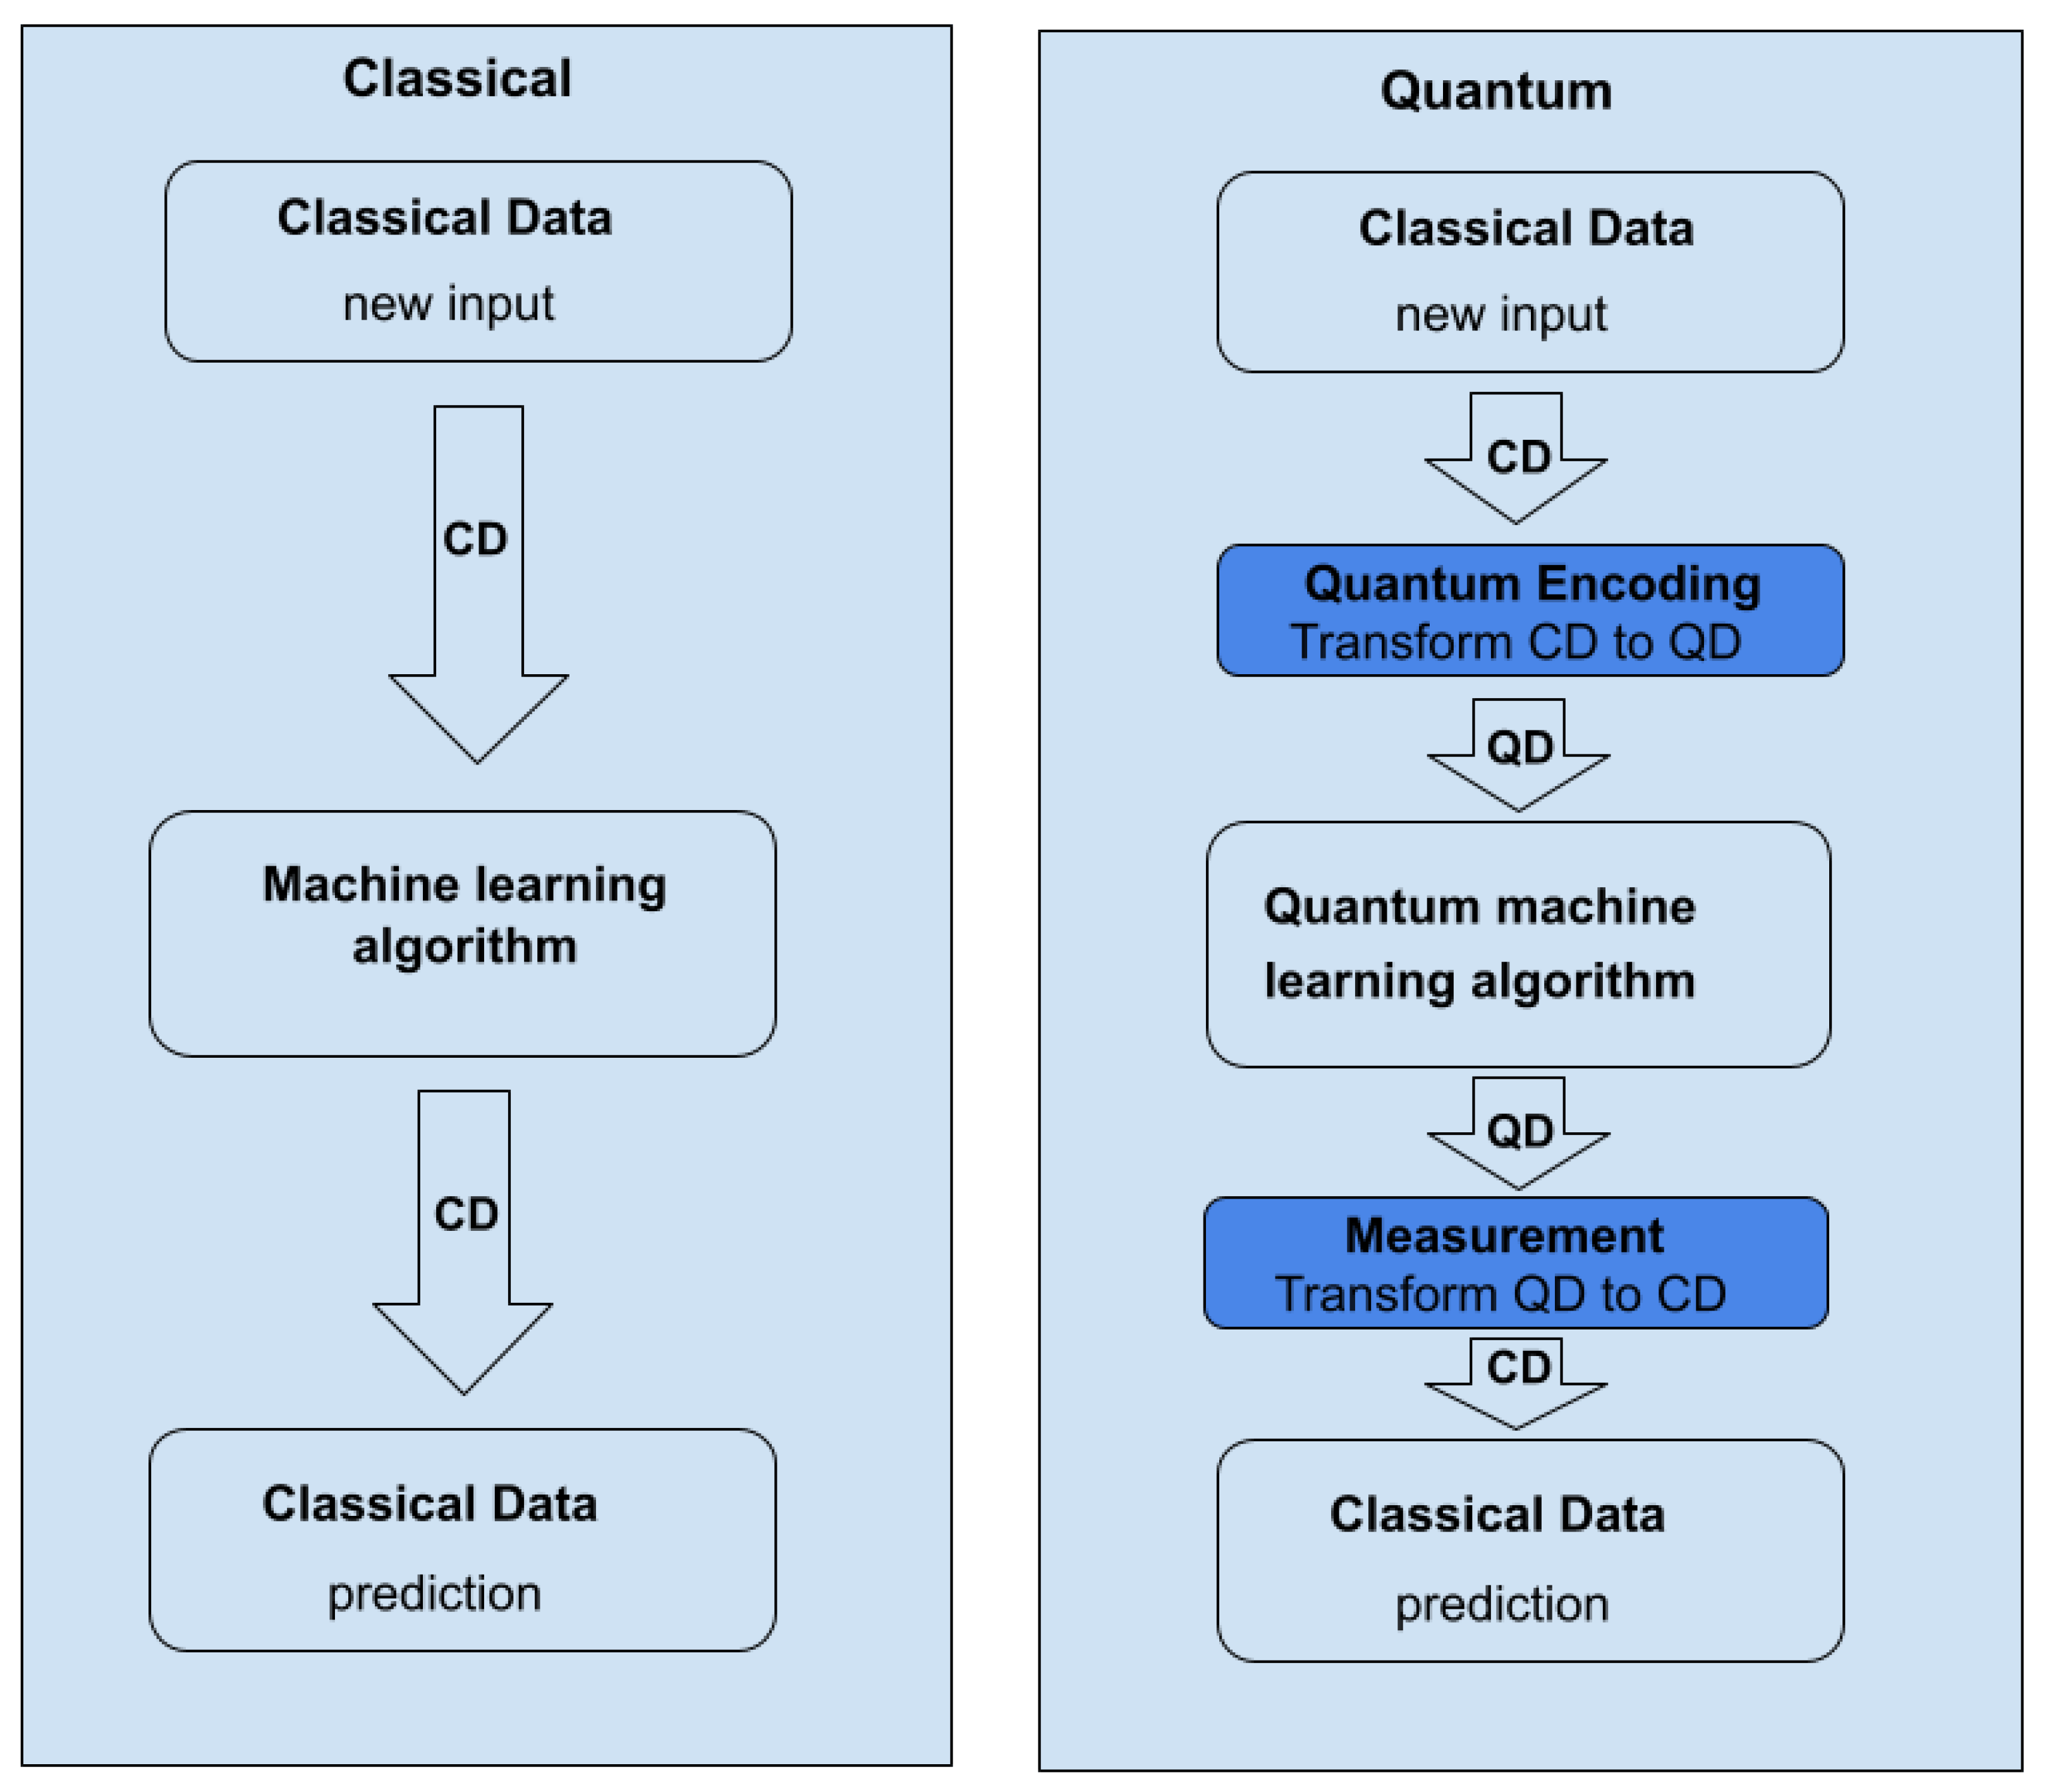
QML Process

Slide 25
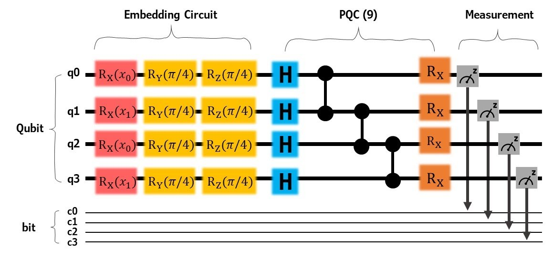
Activity 1: Designing QML Algorithm Circuit

Slide 26
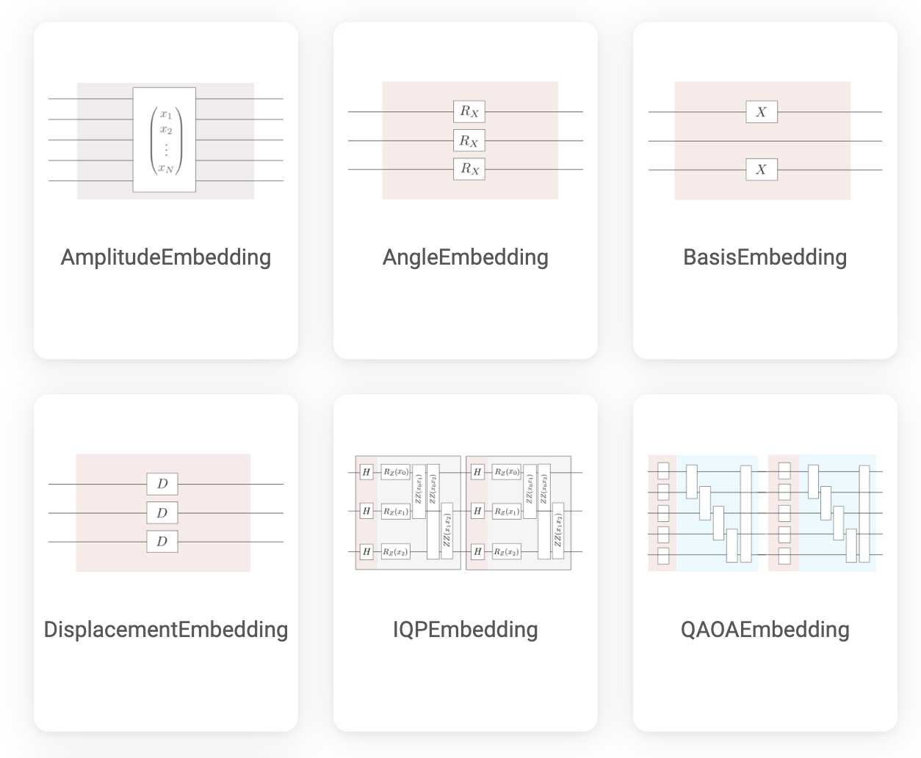
QML Encoding
Before a QML process, one need to encode data from classical data to quantum mechanical state (convert to quantum data).

Slide 27
Activity1: Designing QML Algorithm with Quantum Composer
Initialize Qubit
Create Superposition
Encode data
Apply
Entanglement
Measure
Start with all qubits in the |0⟩ state
Apply a Hadamard gate to each qubit
Angle
Encoding using rotation gates
Apply CNOT gates
Measure to obtain the output

Slide 28
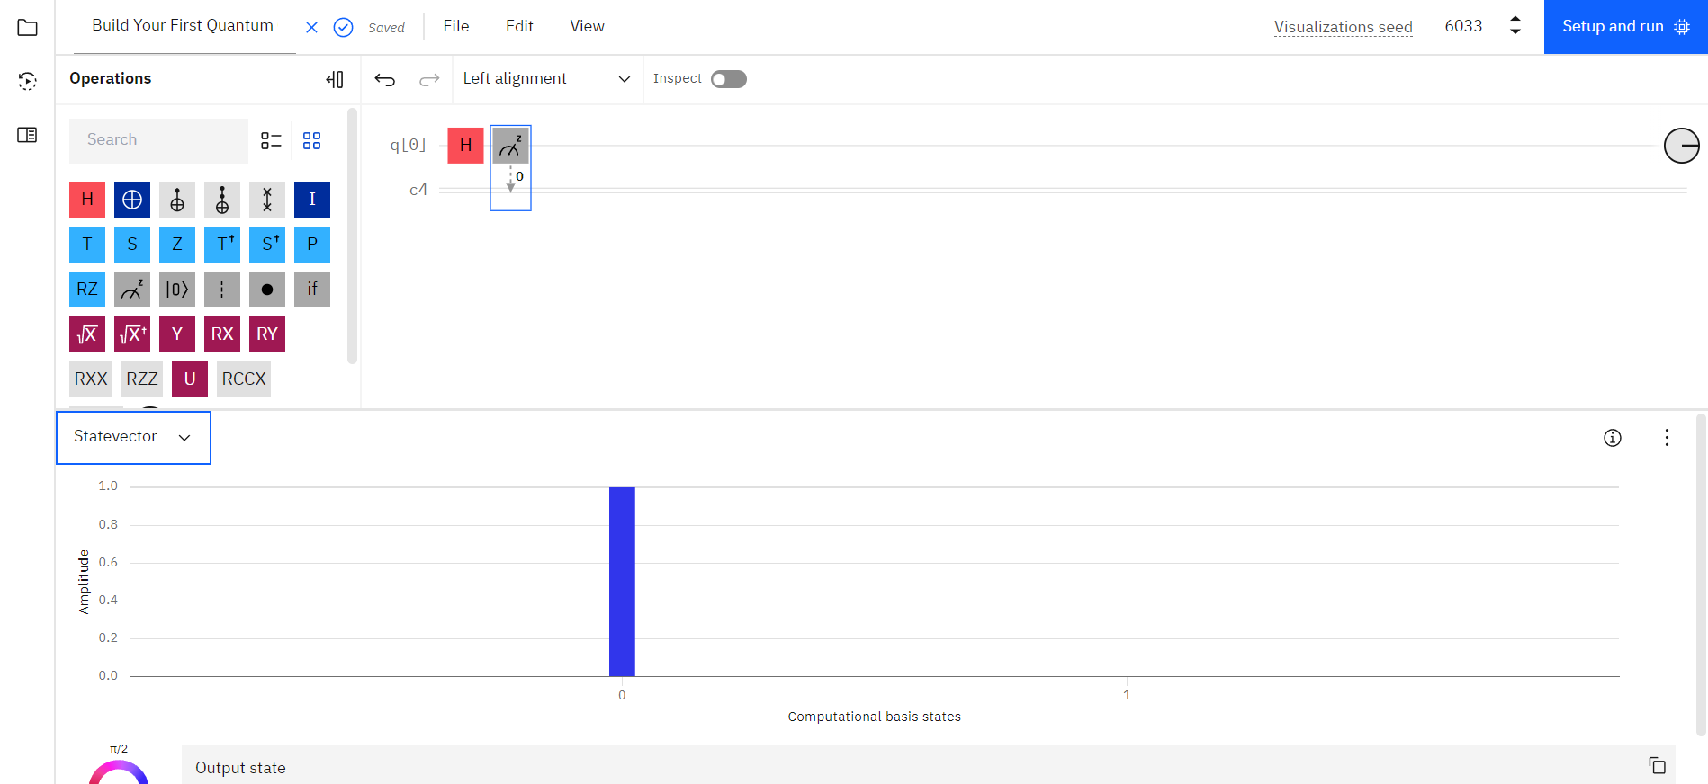
Running a Quantum Circuit
Notes:
If you are logged into an IBMid account, you should see a Setup and Run button in the top right of your screen. If you see “Sign in to run your quantum circuit,” you can click there to sign in or create an account.

Slide 29
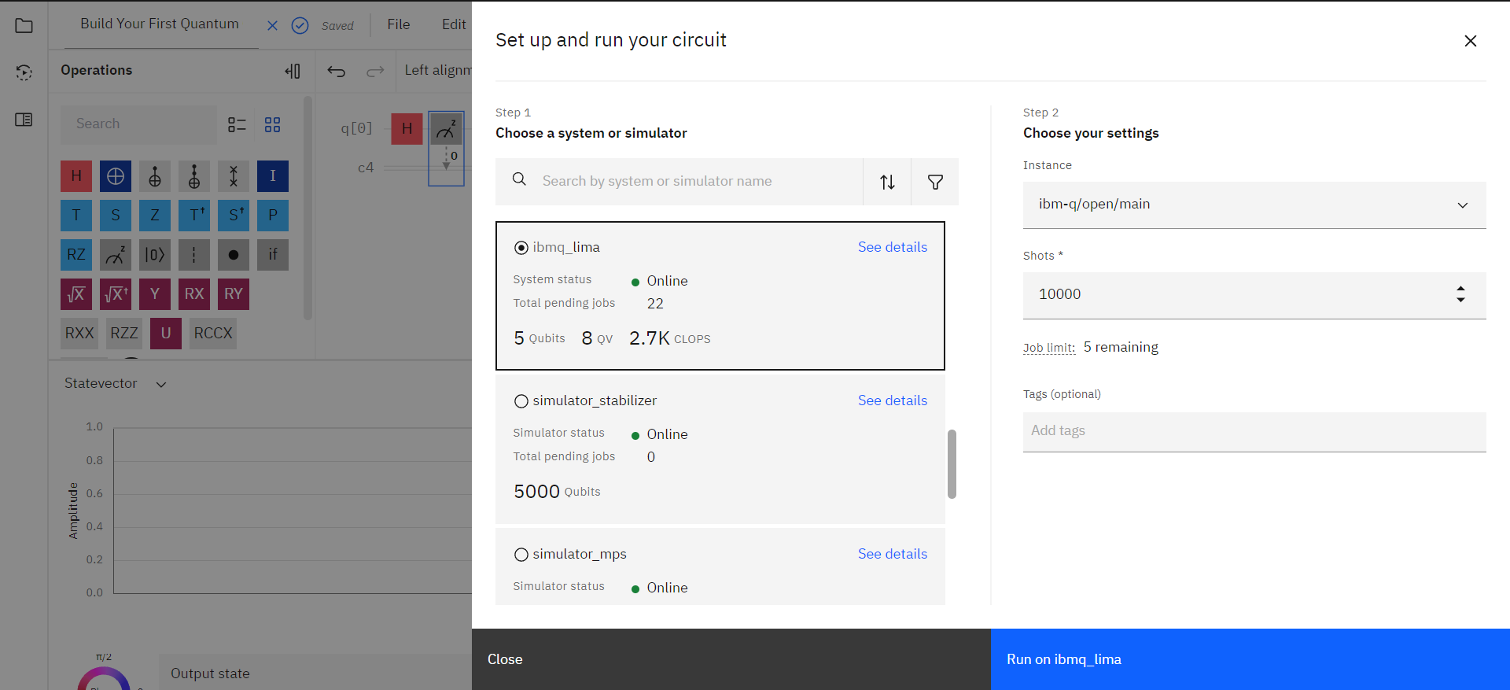
Running a Quantum Circuit
Notes:
Here you can select what system you want to run your circuit on. Simulators (classical computers) have “simulator” in their name, and all the others are real quantum computers! We need to make sure the quantum computer has enough qubits to run our circuit, but because we only need 1 qubit, any computer should work.

Slide 30
Running a Quantum Circuit
Notes:
It is always a good idea to check the number of pending jobs on the machine you want to use. these computers are first come, first serve, so if there are lots of pending jobs, we may have to wait a long time to get our results back from the quantum computer.

Slide 31
Running a Quantum Circuit
Notes:
Here we can specify the number of times we run our quantum circuit (shots).

Slide 32
Running a Quantum Circuit
Notes:
Once we are ready to run out quantum circuit, we can click the Run button in the bottom right!

Slide 33
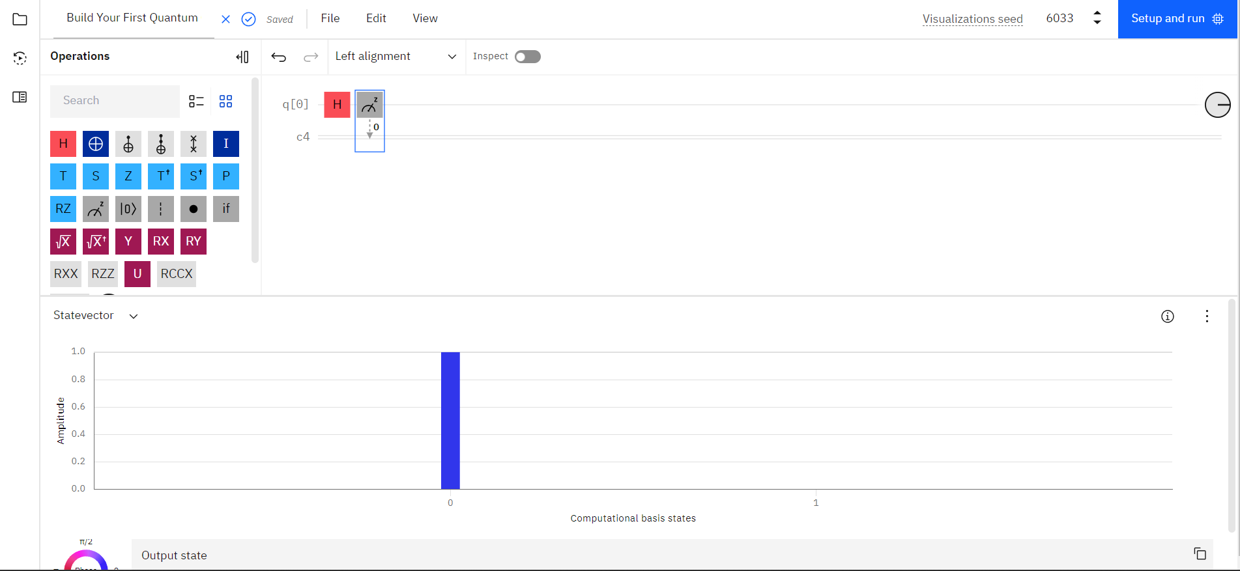
Running a Quantum Circuit
After we submit our job, we can check the status by clicking the play symbol on the left.

Slide 34
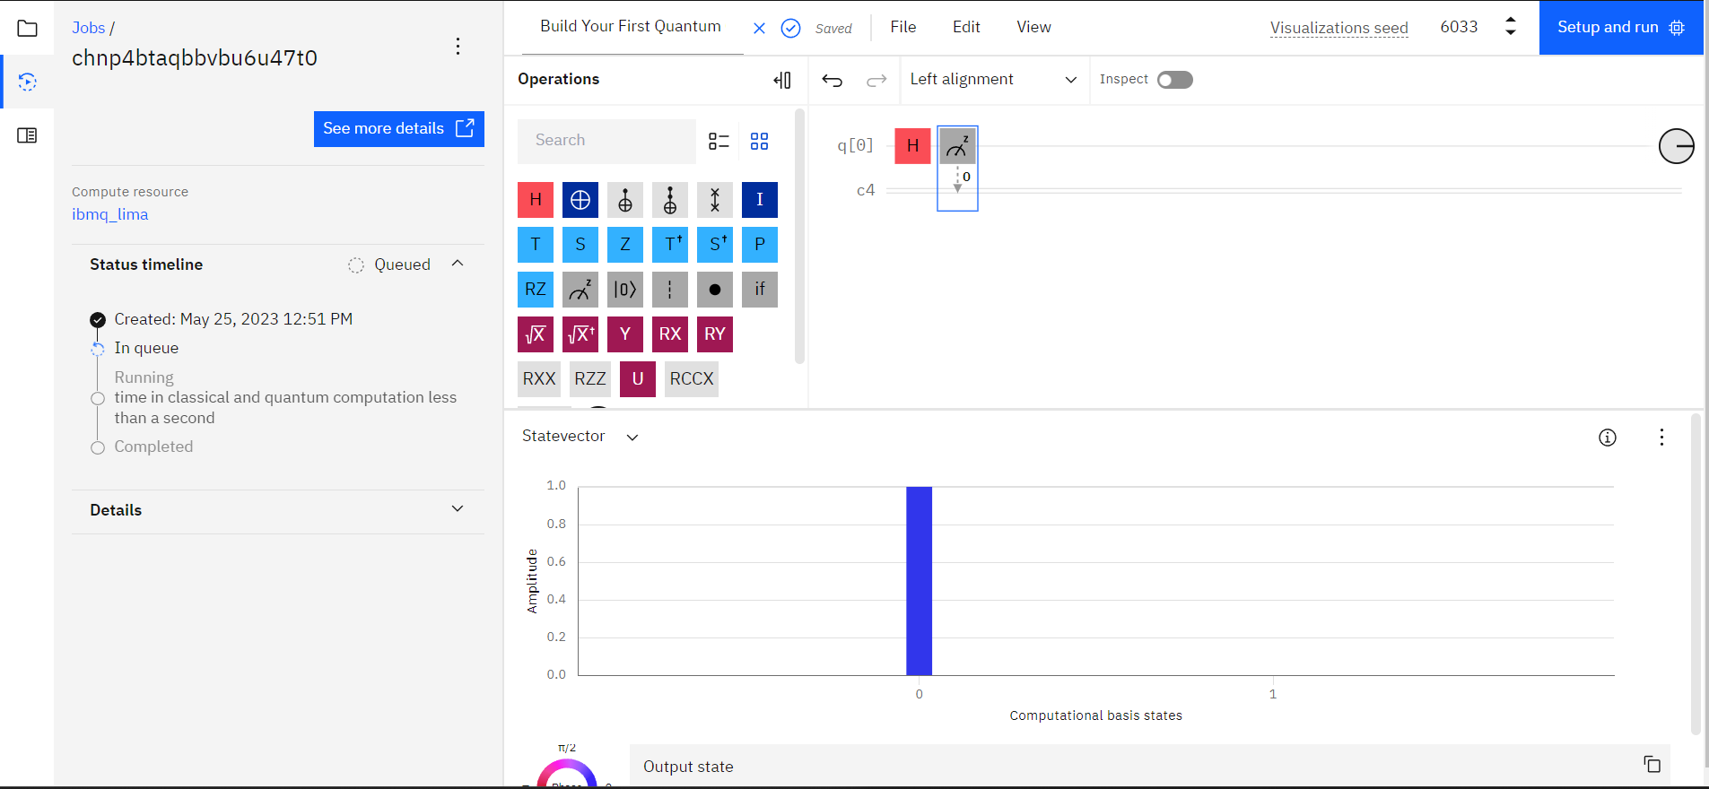
Running a Quantum Circuit
Notes:
Your job will be queued until it is your turn to use the Quantum Computer.

Slide 35
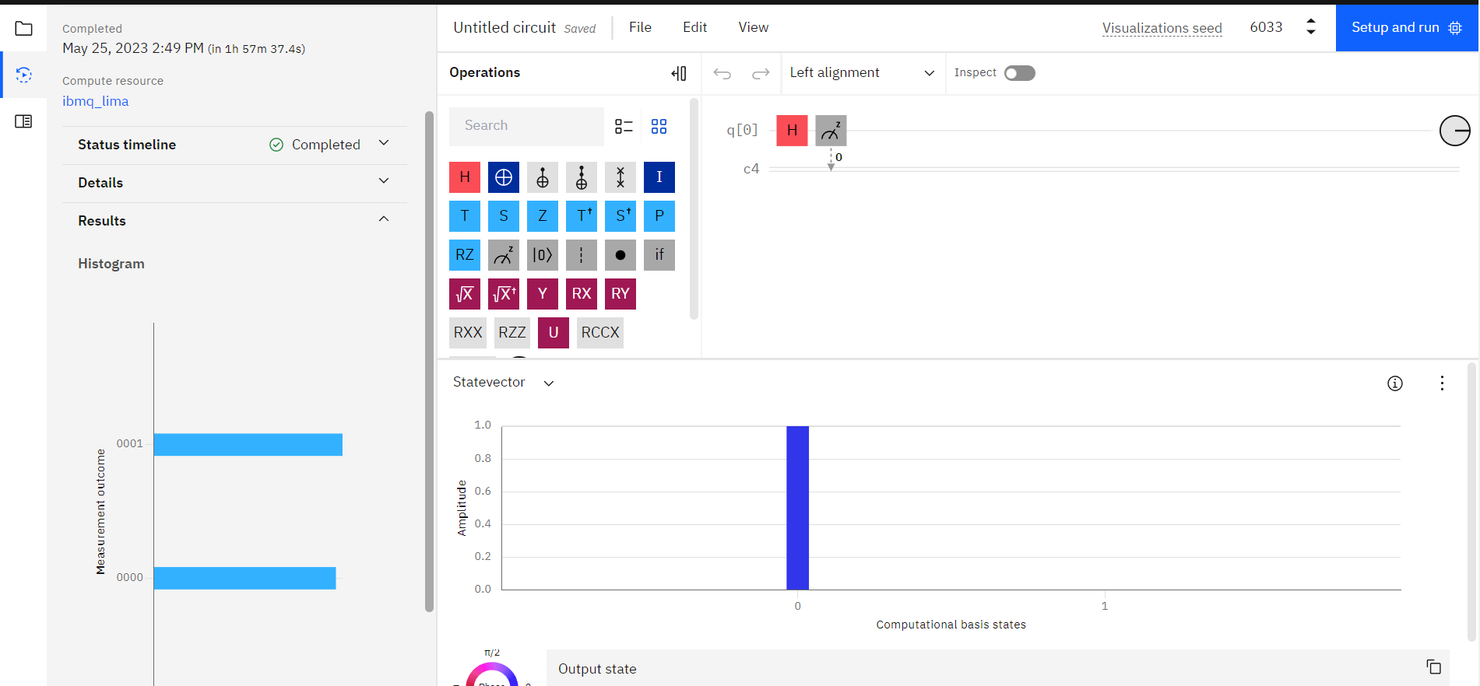
Running a Quantum Circuit
Once your job is finished running, you will see the result shown below

Slide 36
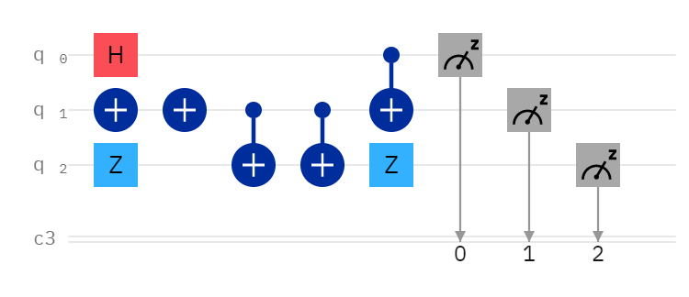
Activity 1: Implement this Algorithm on the Quantum Composer

Slide 37
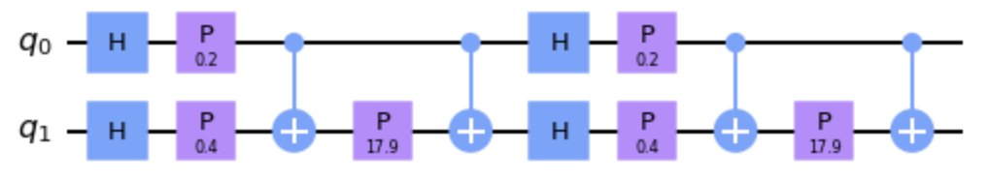
Activity 2: Implement the FeatureMap on the Quantum Composer

